Slide 1

Research Question –
Tutorial Presentation for Feedback
Date:
Group Name: Name of Student Presenting:

Slide 2
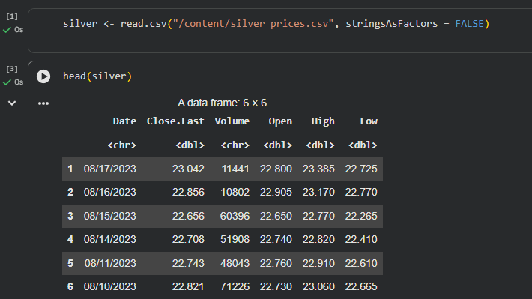
Dataset ID: Silver Prices Dataset (2013–2023)
Total Rows: 2,481 daily observations
Variables used in our Research Question:
Trading Volume (Independent variable – interval / measurement)
Closing Price (USD/oz) (Dependent variable – interval / measurement)
Here is a sample of our dataset:

Slide 3
This dataset is interesting to us because it captures how global economic conditions, investor behaviour, and commodity market activity influence silver pricing dynamics.
Our Independent variable is : Trading Volume
This Independent variable datatype is : Interval (numeric)
Our Dependent variable is: Closing Price (USD/oz)
This Dependent variable datatype is : Interval (numeric)
Dataset ID: (replace this text with your DSXXX number and filename)
Notes:
Before specifying your Research Question you must define the type of data you are analysing. Are the variables you select interval data (measurement data you can divide, multiple, etc), OR are they ordinal (there is a definite order but the intervals between each variable are not necessarily equal, or the terms might be subjective like in a likert scale); OR are they just categorical/nominal (Items such as film names, cities, etc., that you can count numbers of occurrences? You also need to understand whether the variable is either dependent or independent and this will vary according to the context. Independent variables may cause an effect, whereas the dependent variable might be effected by the independent variable. Check the lecture notes on the RQ for more information and examples.
You will get only one opportunity to present your Research Question ahead of the submission date. Have your questions ready, and be ready to take notes on feedback.

Slide 4
“Is there a significant correlation between the daily trading volume (independent variable) and the closing price of silver (dependent variable)?”
This follows Template 1 (Correlation):“Is there a correlation between [dependent interval/ordinal variable] and [independent interval/ordinal variable]?”
Our Research Question is

Slide 5
PRE 7COM1079-2025 Student Group No: ?????
Hypotheses
Null hypothesis (H₀): There is no correlation between trading volume (independent variable) and the closing price of silver (dependent variable).
2. Alternative hypothesis (H₁): There is a correlation between trading volume (independent variable) and the closing price of silver (dependent variable).

Slide 6
Scatterplot: Volume vs Closing Price
The scatterplot visualises the relationship between trading volume (independent variable) and closing price (dependent variable). A linear trendline is included to help identify the direction and strength of association. The plot shows a weak but positive upward trend, consistent with our research question on correlation.
Visualisation Part 1 (Scatterplot)

Slide 7
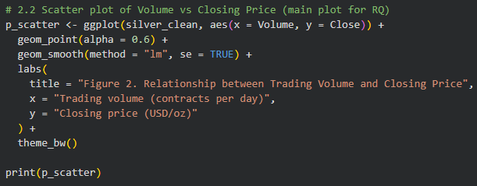
Visualisation Part 1 (Scatterplot Code)

Slide 8
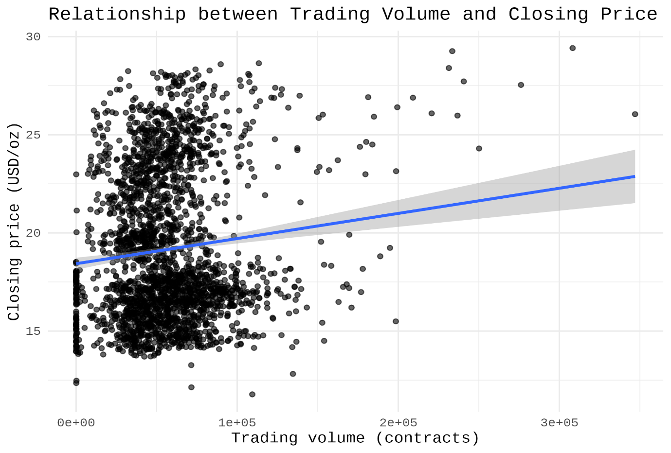
Visualisation Part 1 (Scatterplot)

Slide 9
Histogram of Daily Closing Prices
This histogram shows the frequency distribution of the dependent variable, Closing Price, with a normal curve overlay. The distribution is moderately skewed but still suitable for a Pearson correlation test due to the large sample size (n = 2476).
Visualisation Part 2 (Histogram + Normal Curve)

Slide 10
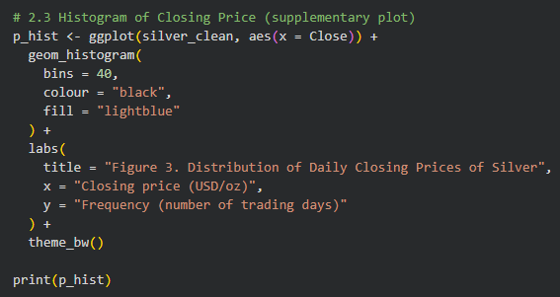
Visualisation Part 2 (Histogram Code)

Slide 11
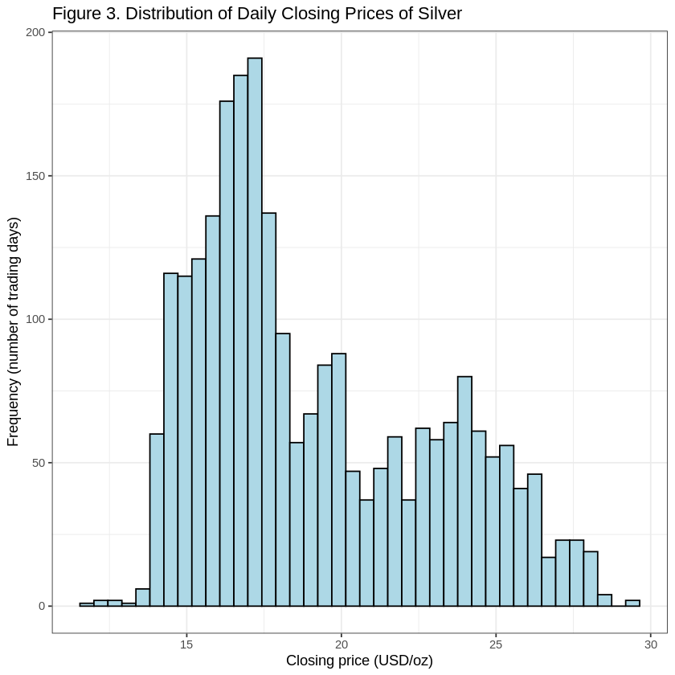
Visualisation Part 2 (Histogram + Normal Curve)

Slide 12
Statistical Test Used
We use Pearson’s correlation coefficient because both the independent and dependent variables are continuous interval-level measures. Pearson’s r is appropriate for examining linear relationships and is widely used in financial time-series analysis.
Analysis: Statistical Test

Slide 13
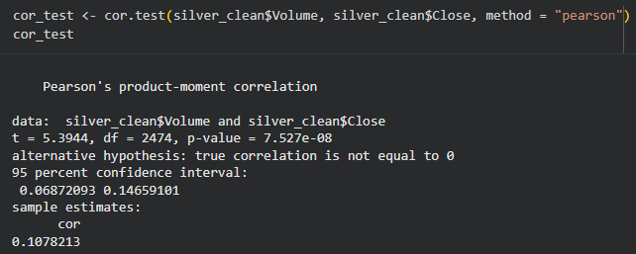
Pearson’s r: 0.1078 p-value: 7.527e-08
95% CI: 0.0687 – 0.1466
Decision: p < 0.05 → We reject the null hypothesis.
Statistical Output & Interpretation

Slide 14
Interpretation:
Although the correlation is weak (r ≈ 0.11), it is statistically significant. This suggests that higher trading volumes are modestly associated with higher silver closing prices. In financial markets, even weak correlations can indicate meaningful behavioural patterns among investors.
Statistical Output & Interpretation

Slide 15
The relationship between trading volume and silver price is weak but statistically significant.
This supports our research question and allows us to reject H₀.
The findings align with previous literature showing volume as a mild indicator of price movements in commodities markets.
Future work could analyse non-linear models or include additional variables (e.g., volatility, global economic indicators).
Conclusion

Slide 16
THANK YOU

